Slide 1
Azure Data Explorer
What is Azure Data Explorer
When you should use Azure Data Explorer
What makes Azure Data Explorer Unique

Slide 2
What is Azure Data Explorer
Azure Data Explorer is a fully managed, high-performance, big data analytics platform that makes it easy to analyze high volumes of data in near real time. The Azure Data Explorer toolbox gives you an end-to-end solution for data ingestion, query, visualization, and management.
By analyzing structured, semi-structured, and unstructured data across time series, and by using Machine Learning, Azure Data Explorer makes it simple to extract key insights, spot patterns and trends, and create forecasting models. Azure Data Explorer is scalable, secure, robust, and enterprise-ready, and is useful for log analytics, time series analytics, IoT, and general-purpose exploratory analytics.
Azure Data Explorer capabilities are extended by other services built on its powerful query language, including Azure Monitor logs, Application Insights, Time Series Insights, and Microsoft Defender for Endpoint.

Slide 3
When you should use Azure Data Explorer
Use the following questions to help decide if Azure Data Explorer is right for your use case:
Interactive analytics: Is interactive analysis part of the solution? For example, aggregation, correlation, or anomaly detection.
Variety, Velocity, Volume: Is your schema diverse? Do you need to ingest massive amounts of data in near real-time?
Data organization: Do you want to analyze raw data? For example, not fully curated star schema.
Query concurrency: Will multiple users or processes use Azure Data Explorer?
Build vs Buy: Do you plan on customizing your data platform?
Azure Data Explorer is ideal for enabling interactive analytics capabilities over high velocity, diverse raw data. Use the following decision tree to help you decide if Azure Data Explorer is right for you:

Slide 4
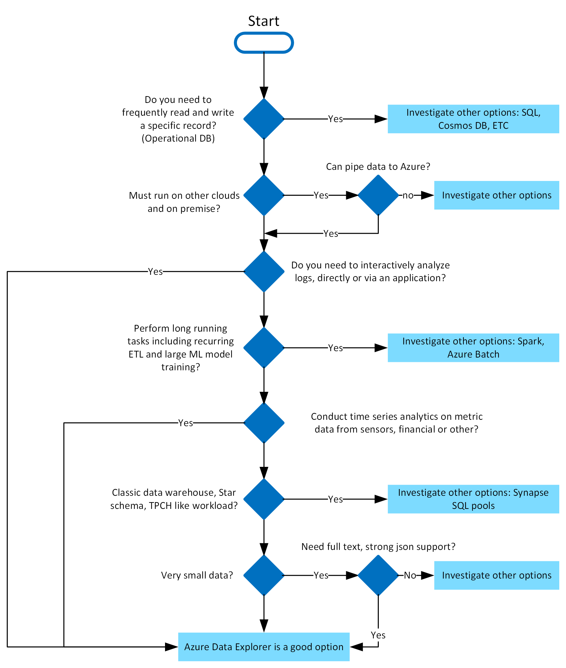

Slide 5
What makes Azure Data Explorer Unique
Data velocity, variety, and volume
With Azure Data Explorer, you can ingest terabytes of data in minutes in batch or streaming mode. You can query petabytes of data, with results returned within milliseconds to seconds. Azure Data Explorer provides high velocity (millions of events per second), low latency (seconds), and linear scale ingestion of raw data. Ingest your data in different formats and structures, flowing from various pipelines and sources.
User-friendly query language
Query Azure Data Explorer with the Kusto Query Language (KQL), an open-source language initially invented by the team. The language is simple to understand and learn, and highly productive. You can use simple operators and advanced analytics.

Slide 6
What makes Azure Data Explorer Unique
Advanced analytics
Use Azure Data Explorer for time series analysis with a large set of functions including: adding and subtracting time series, filtering, regression, seasonality detection, geospatial analysis, anomaly detection, scanning, and forecasting. Time series functions are optimized for processing thousands of time series in seconds. Pattern detection is made easy with cluster plugins that can diagnose anomalies and do root cause analysis. You can also extend Azure Data Explorer capabilities by embedding python code in KQL queries.
Easy-to-use wizard
The ingestion wizard makes the data ingestion process easy, fast, and intuitive. The Azure Data Explorer web UI provides an intuitive and guided experience that helps you ramp-up quickly to start ingesting data, creating database tables, and mapping structures. It enables one time or a continuous ingestion from various sources and in various data formats. Table mappings and schema are auto suggested and easy to modify.

Slide 7
What makes Azure Data Explorer Unique
Versatile data visualization
Data visualization helps you gain important insights. Azure Data Explorer offers built-in visualization and dashboarding out of the box, with support for various charts and visualizations. It has native integration with Power BI, native connectors for Grafana, Kibana and Databricks, ODBC support for Tableau, Sisense, Qlik, and more.
Automatic ingest, process, and export
Azure Data Explorer supports server-side stored functions, continuous ingest, and continuous export to Azure Data Lake store. It also supports ingestion time-mapping transformations on the server side, update policies, and precomputed scheduled aggregates with materialized views.

Slide 8
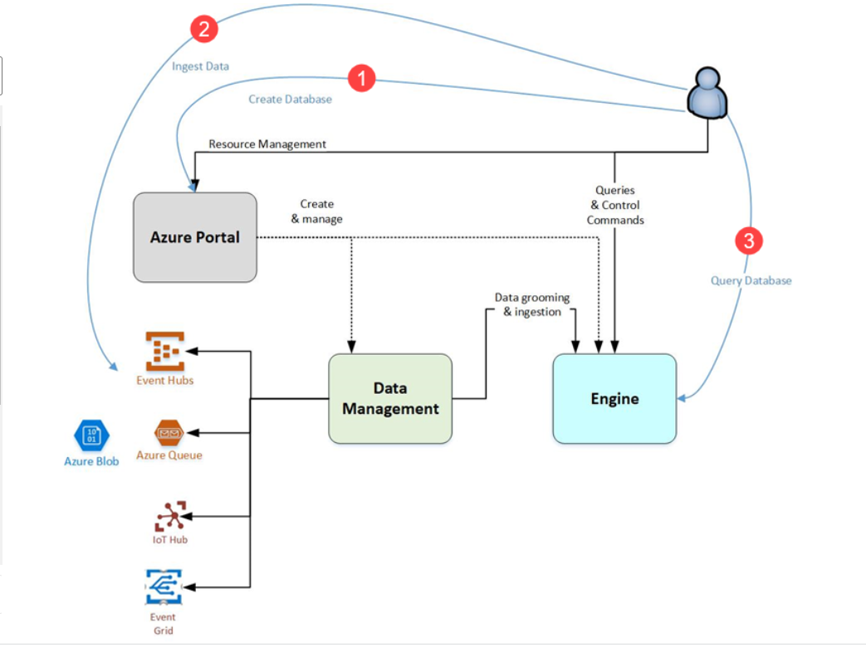
Azure Data Explorer flow
The following diagram shows the different aspects of working with Azure Data Explorer.

Slide 9
Generally speaking, when you interact with Azure Data Explorer, you're going to go through the following workflow:
Create database: Create a cluster and then create one or more databases in that cluster. Each Azure Data Explorer cluster can hold up to 10,000 databases and each database up to 10,000 tables. The data in each table is stored in data shards also called “extents”. All data is automatically indexed and partitioned based on the ingestion time. This means you can store a lot of varied data and because of the way it's stored, you get fast access to querying it. Quickstart: Create an Azure Data Explorer cluster and database
2.Ingest data: Load data into database tables so that you can run queries against it. Azure Data Explorer supports several ingestion methods, each with its own target scenarios. These methods include ingestion tools, connectors and plugins to diverse services, managed pipelines, programmatic ingestion using SDKs, and direct access to ingestion. Get started with one-click ingestion.

Slide 10
3.Query database: Azure Data Explorer uses the Kusto Query Language, which is an expressive, intuitive, and highly productive query language. It offers a smooth transition from simple one-liners to complex data processing scripts, and supports querying structured, semi-structured, and unstructured (text search) data. There's a wide variety of query language operators and functions (aggregation, filtering, time series functions, geospatial functions, joins, unions, and more) in the language. KQL supports cross-cluster and cross-database queries, and is feature rich from a parsing (json, XML, and more) perspective. The language also natively supports advanced analytics.
Use the web application to run, review, and share queries and results. You can also send queries programmatically (using an SDK) or to a REST API endpoint. If you're familiar with SQL, get started with the SQL to Kusto cheat sheet. Quickstart: Query data in Azure Data Explorer web UI
4.Visualize results: Use different visual displays of your data in the native Azure Data Explorer Dashboards. You can also display your results using connectors to some of the leading visualization services, such as Power BI and Grafana. Azure Data Explorer also has ODBC and JDBC connector support to tools such as Tableau and Sisense.

Slide 11
Azure Data Explorer connector for Microsoft Power Automate
The Azure Data Explorer connector for Power Automate (previously Microsoft Flow) enables you to orchestrate and schedule flows, send notifications, and alerts, as part of a scheduled or triggered task.
Send notifications and alerts based on query results, such as when thresholds exceed certain limits.
Send regular, such as daily or weekly, reports containing tables and charts.
Schedule regular jobs using control commands on cluster.
Export and Import data between Azure Data Explorer and other databases.

Slide 12
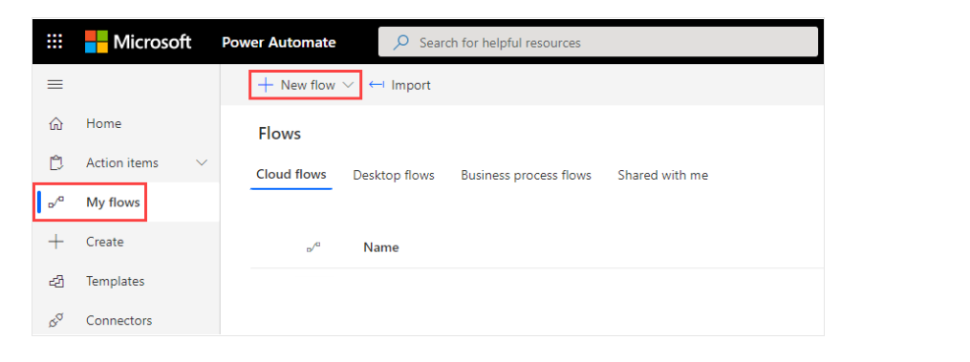
Create a new flow using the Azure Data Explorer connector
1.Sign in to Power Automate.
2.Create a new flow, or, from the Power Automate home page, select the My flows > + New flow.

Slide 13
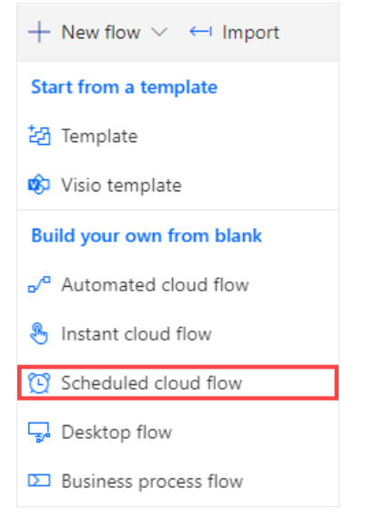
Create a new flow using the Azure Data Explorer connector
Select Scheduled cloud flow.

Slide 14
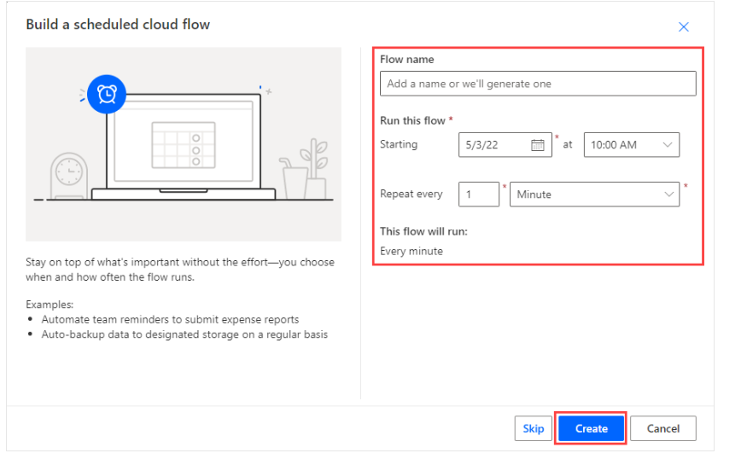
Create a new flow using the Azure Data Explorer connector
In Build a scheduled cloud flow, enter the required information.

Slide 15
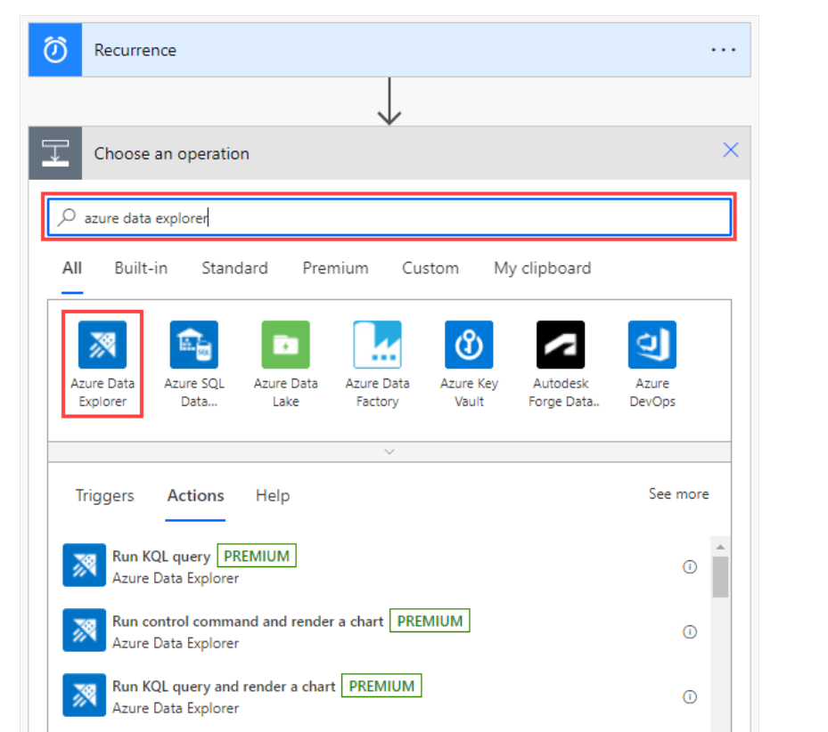
Create a new flow using the Azure Data Explorer connector
Select Create > + New step.
In the search box, enter Kusto or Azure Data Explorer, and select Azure Data Explorer.

Slide 16
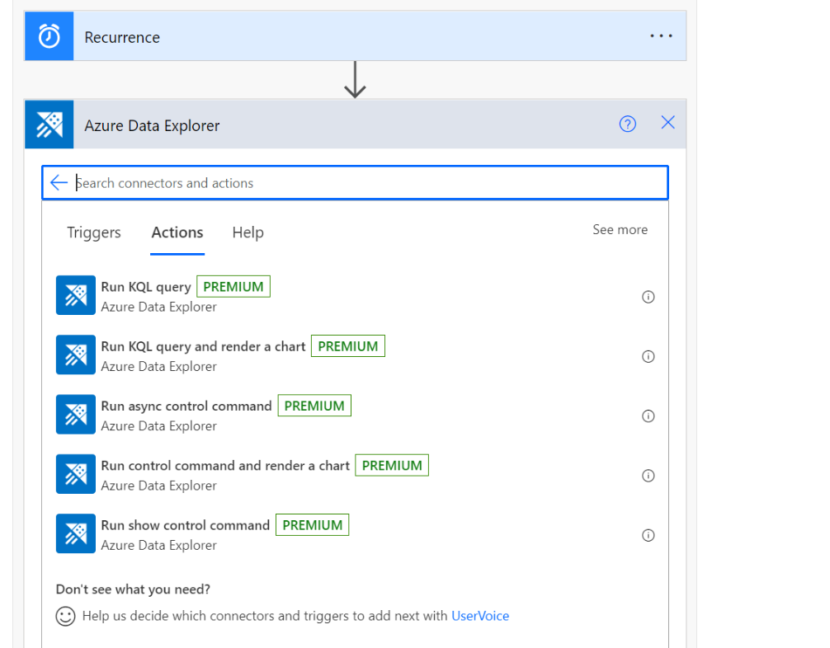
Create a new flow using the Azure Data Explorer connector
Select an action from the list. For an explanation of each action and how to configure them, see Flow actions.

Slide 17
Flow actions
When you select the Azure Data Explorer connector, you can choose one of the following actions to add to your flow:
Run KQL query
Run KQL query and render a chart
Run async control command
Run control command and render a chart
Run show control command
This section describes the capabilities and parameters for each action and provides an example showing how to add an email action to any flow.

Slide 18
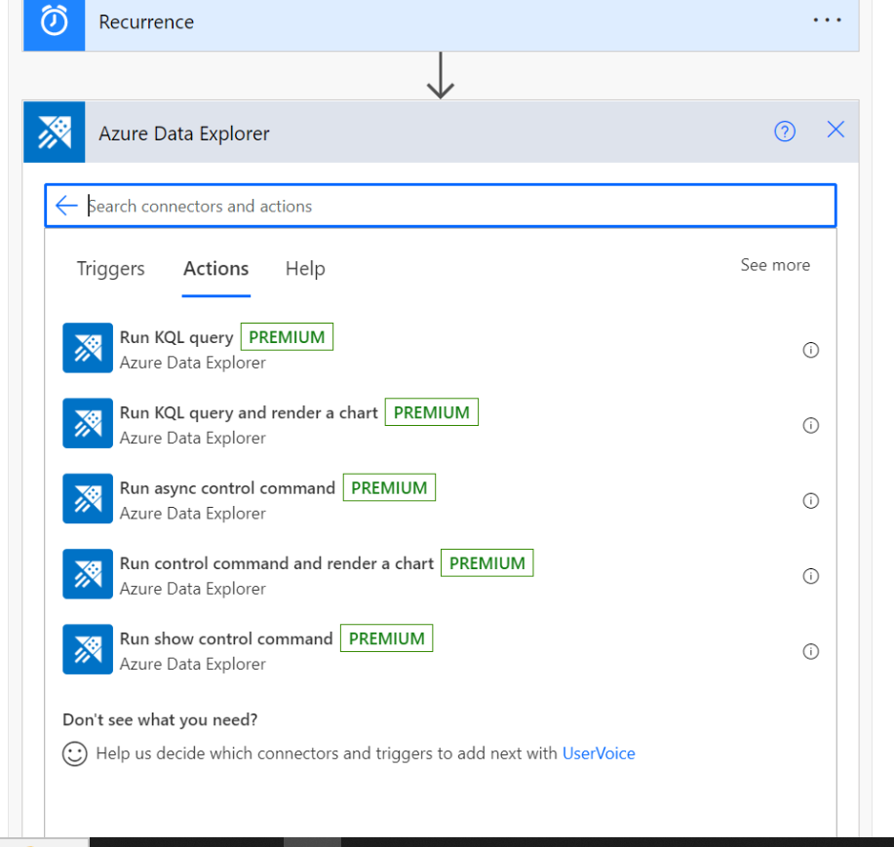
Flow actions

Slide 19
Run KQL query
This action sends a query to the specified cluster. The actions that are added afterwards iterate over each line of the results of the query.
The following example triggers a query every minute, and sends an email based on the query results. The query checks the number of records in the table, and then sends an email only if the number of records is greater than 0.

Slide 20
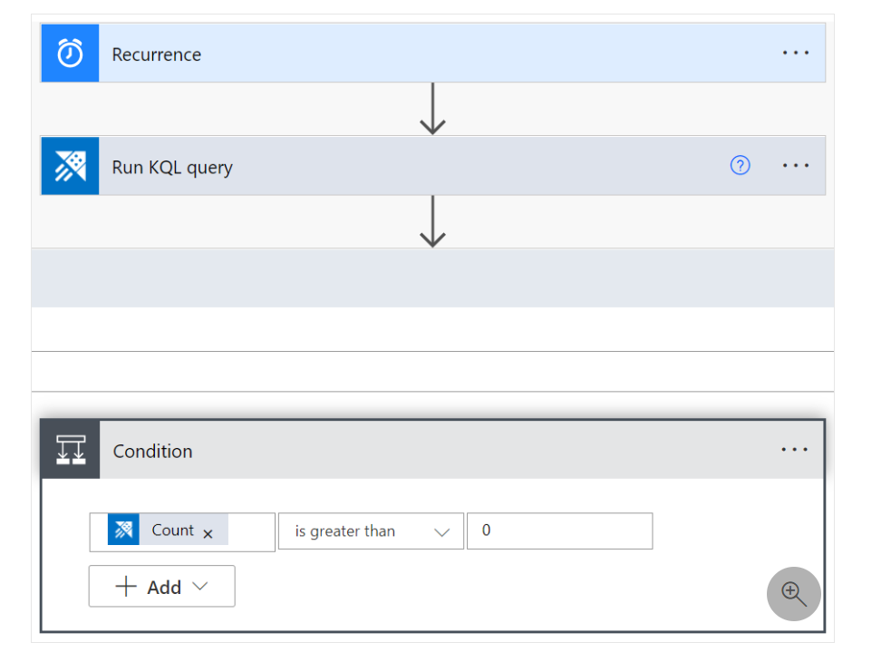
Run KQL query

Slide 21
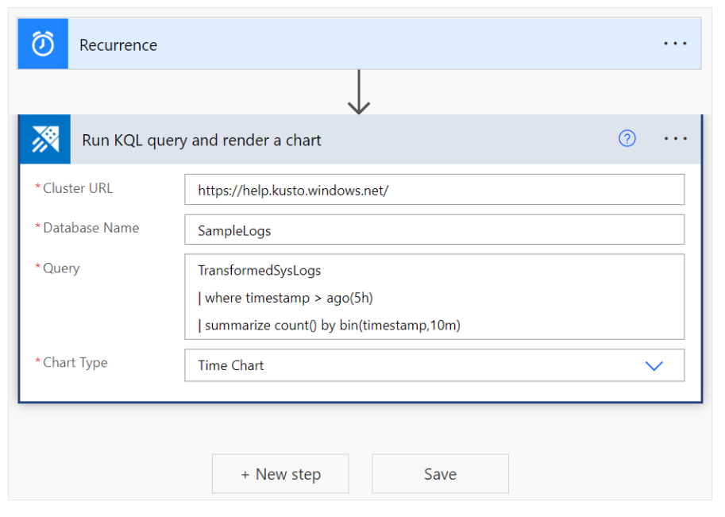
Run KQL query and render a chart
Use this action to visualize a KQL query result as a table or chart. For example, use this flow to receive daily reports by email.
In this example, the results of the query are returned as a timechart.

Slide 22
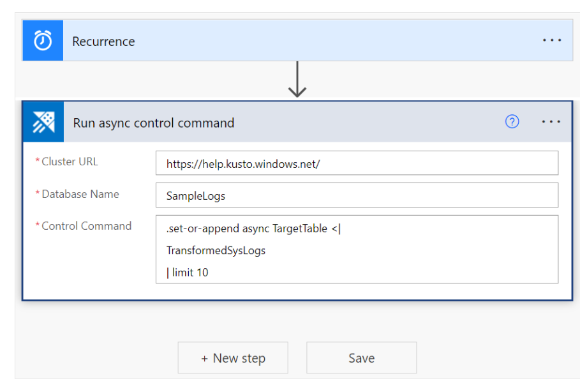
Run async control command
This action runs control command in async mode and returns its ID, state and status on completion. 'async' keyword is mandatory. It's always recommended to execute control commands in async mode so they keep running in the background. KQL commands can run for maximum of 1 hour. Also, you get an operation ID of the async command after execution that can be used with .show operations OPERATION_ID_RETURNED_BY_CMD command to get the status and details of that async command.
The following example triggers an async command to copy the sample 10 records from 'TransformedSysLogs' table to 'TargetTable'.

Slide 23
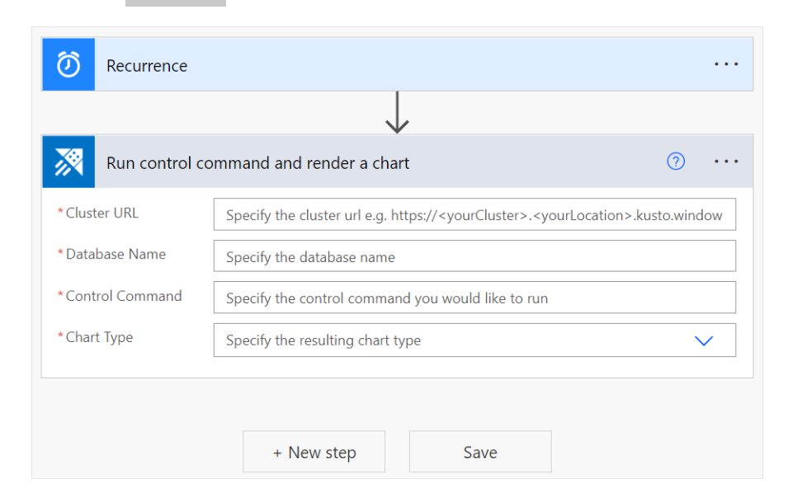
Run control command and render a chart
Use this action to run a control command and get the result as a chart of your choice.
Specify the cluster URL. For example, https://clusterName.eastus.kusto.windows.net.
Enter the name of the database.
Specify the control command:
Select dynamic content from the apps and connectors used in the flow.
Add an expression to access, convert, and compare values.
To send the results of this action by email as a table or a chart, specify the chart type. This can be:
An HTML table.
A pie chart.
A time chart.
A bar chart.

Slide 24
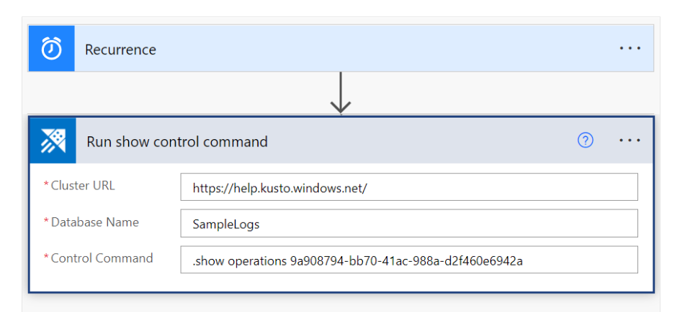
Run show control command
This action runs the show control command and returns the result that can be used in the following connectors.
The following example executes the .show operation command to find the status of an async command using an operation ID returned by an async command execution.

Slide 25
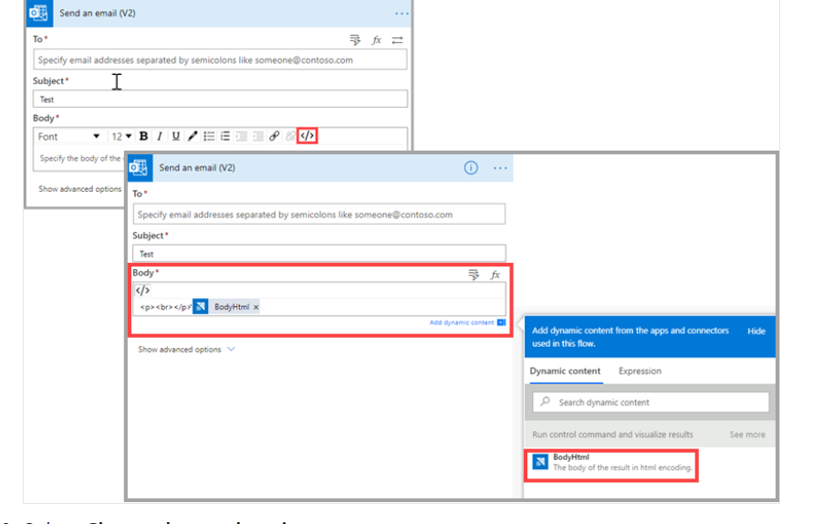
Email Kusto query results
You can include a step in any flow to send reports by email, to any email address.
Select + New Step to add a new step to your flow.
In the search box, enter Office 365 and select Office 365 Outlook.
Select Send an email (V2).
Enter the email address to which you want the email report sent.
Enter the subject of the email.
Select Code view.
Place your cursor in the Body field, and select Add dynamic content.
Select BodyHtml.

Slide 26
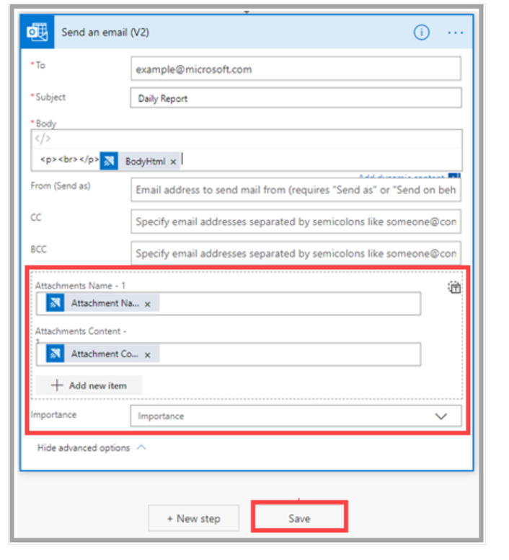
Email Kusto query results
Select Show advanced options.
Under Attachments Name -1, select Attachment Name.
Under Attachments Content, select Attachment Content.
If necessary, add more attachments.
If necessary, set the importance level.
Select Save.

Slide 27
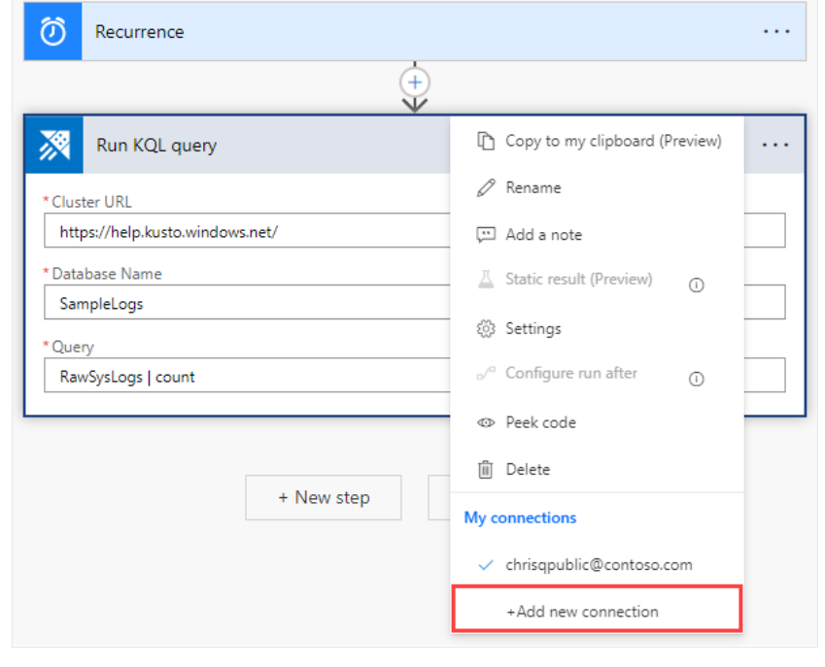
Create an Azure Data Explorer connection
To run a flow that contains an Azure Data Explorer connector, you must use a valid Azure Data Explorer connection. You can create and authenticate a new connection from the Power Automate left pane, select Data > Connections or from within the flow, by selecting the Azure Data Explorer connector's menu > Add new connection.
The following steps show how to create a connection from within a flow.
In Run KQL query, select the three dots at the top right of the power automate connector.

Slide 28
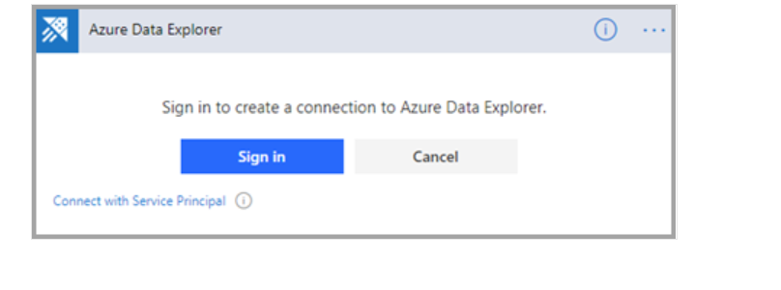
Create an Azure Data Explorer connection
Select Add new connection. When you connect for the first time, you're prompted to sign in to authenticate the connection.

Slide 29
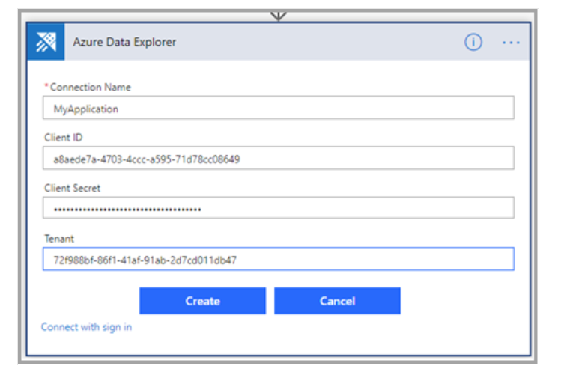
Authentication
You can authenticate with user credentials or with an Azure Active Directory (Azure AD) application. To authenticate with credentials, select Sign in, and enter your credentials.
To authenticate with a Service Principal:
Select Connect with Service Principal.
Fill out the form with the following information:
Connection Name: A descriptive and meaningful name for the new connection. In this example, we've used "MyApplication".
Client ID: Your application ID.
Client Secret: Your application key.
Tenant: The ID of the Azure AD directory in which you created the application.

Slide 30
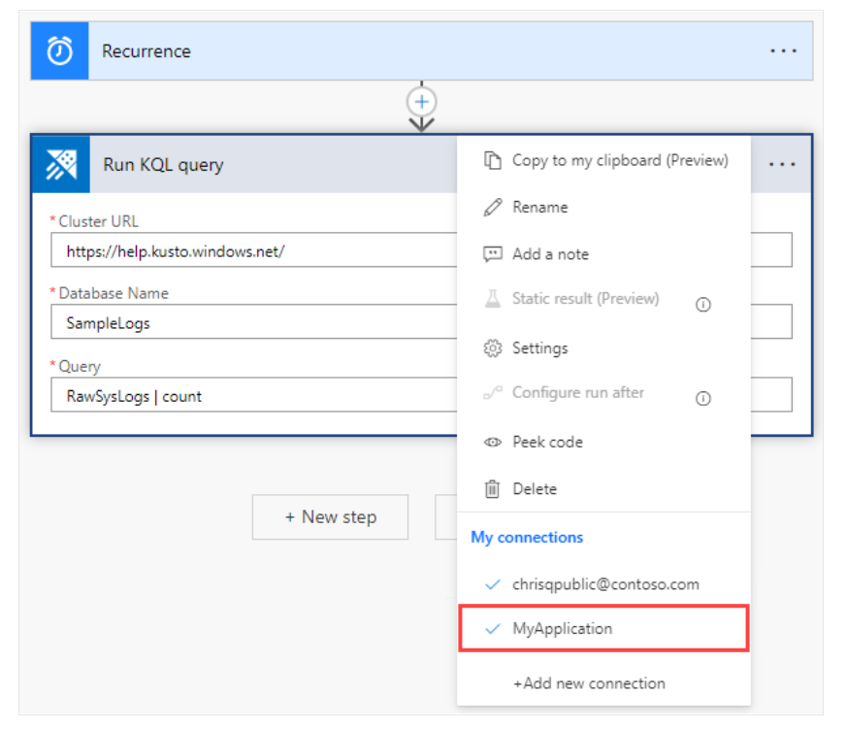
Authentication
When authentication is complete, verify that your flow uses the new connection.
Once the connection is set, the flow runs using the application credentials.

Slide 31
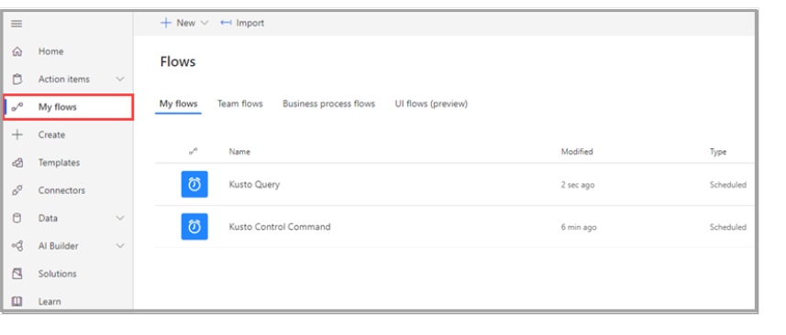
Test the flow
To check if your flow works, check the flow's run history:
Go to the Power Automate home page.
From the main menu, select My flows.

Slide 32
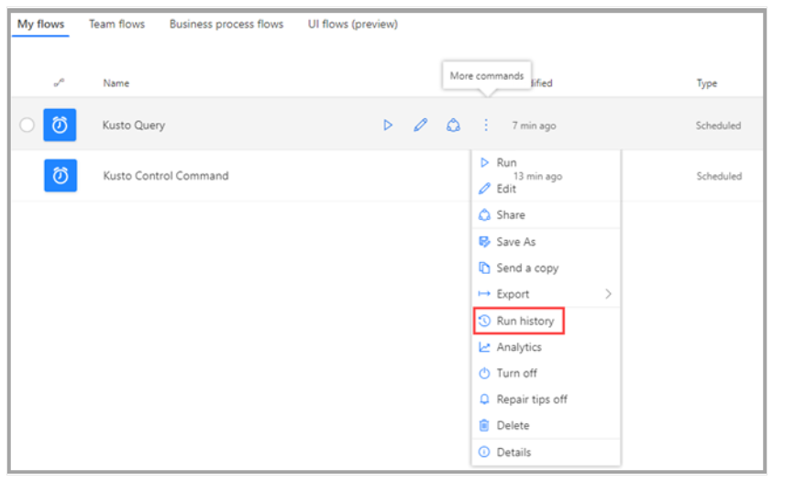
Test the flow
On the row of the flow you want to investigate, select the more commands icon, and then select Run history.

Slide 33
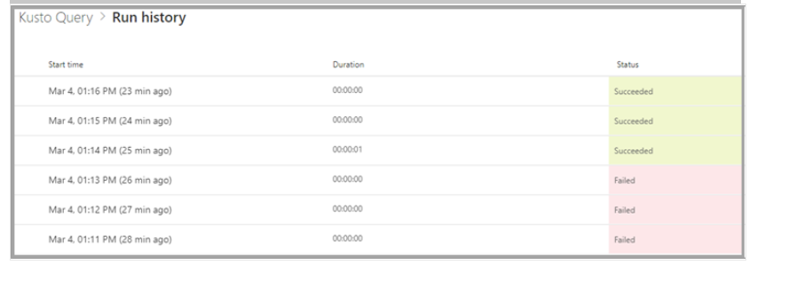
Test the flow
All flow runs are listed, with information about start time, duration, and status.

Slide 34
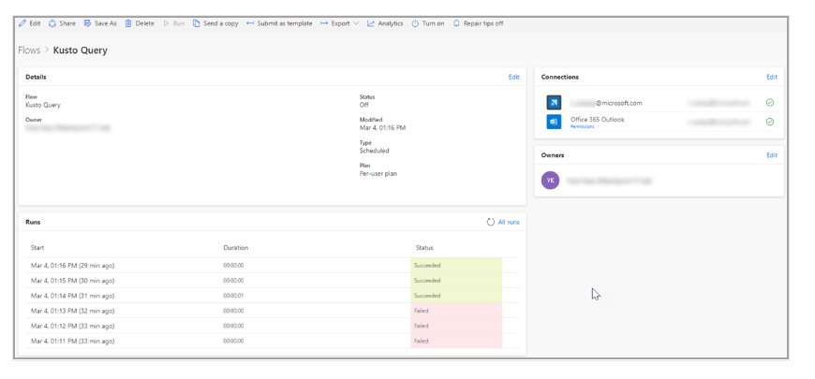
Test the flow
For full details about the flow, on My flows, select the flow you want to investigate.

Slide 35
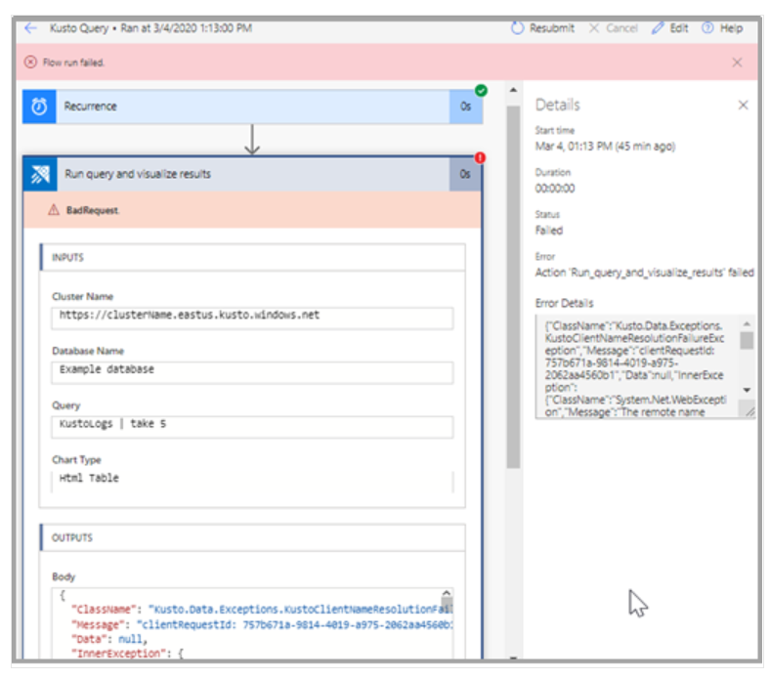
Test the flow
To see why a run failed, select the run start time. The flow appears, and the step of the flow that failed is indicated by a red exclamation point. Expand the failed step to view its details. The Details pane on the right contains information about the failure so that you can troubleshoot it.

Slide 36
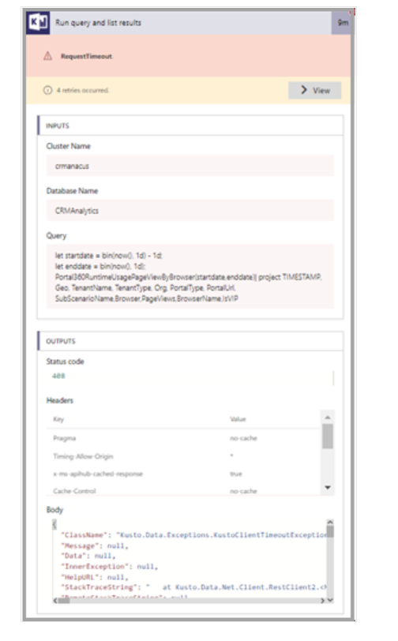
Timeout exceptions
Your flow can fail and return a "RequestTimeout" exception if it runs for more than 90 seconds.

Slide 37
Timeout exceptions
To fix a timeout issue, make your query more efficient so that it runs faster, or separate it into chunks. Each chunk can run on a different part of the query. For more information, see Query best practices.
The same query might run successfully in Azure Data Explorer, where the time isn't limited and can be changed.

Slide 38
Limitations
Results returned to the client are limited to 500,000 records. The overall memory for those records can't exceed 64 MB and a time of 90 seconds to run.
The connector doesn't support operators that aren't supported by the getschema operator. For example, the fork, facet, and evaluate operators aren't supported.
Flows work best on Microsoft Edge and Google Chrome.

Slide 39
End of Slide

